Slide 1

Redistricting Advisory Committee 2015
October 22, 2015
Superintendent Recommendation

Slide 2
Agenda
Process
People
Purpose
Study Objectives
Background Info
Committee Recommendation
Albemarle HS
Superintendent Recommendation
Timeline
Greer ES

Slide 3
process
Introductions
Timeline

Slide 4
People
  COMMITTEE
  Kate Barrett
  Rick Morris
  Symia Feggans
  Candice Love
  James Younger
  Tiffany Barber
  Tania Eastman
  STAFF SUPPORT
  Rosalyn Schmitt, Assistant Director of Facilities Planning
  Dean Tistadt, Chief Operating Officer
  Renee DeVall, Transportation Analyst
  Department of Instruction
  Principals

Slide 5
Timeline
Spring 2015
April 2nd | School Board Approved Objectives of Study
April 28th, May 5th, May 12th | Committee Meeting #1, #2, #3
May 18th | First Community Meeting – 3 scenarios
May 26th | Committee Meeting #4
June 2nd | Second Community Meeting – 2 scenarios
June 9th | Committee Meeting #5
Fall 2015
September 15th; September 22nd | Committee Meeting #6, #7
September 29th | Third Community Meeting
October 6th | Committee Meeting #8 (final)
October 22nd | Superintendent Recommendation to School Board
November 5th | School Board Public Hearing
November 12th | School Board Meeting: Vote
December 2015 | Families to be notified if actions will be taken for 2016/17 school year

Slide 6
purpose
Background Information
Study Objectives

Slide 7
Background
  The Long-Range Planning Advisory Committee (LRPAC) is formed to “inform and advise the Superintendent and School Board in the development of comprehensive, long-term plans for facilities needs in the most effective and efficient way and in support of the School Division’s Strategic Plan.”
  In June 2014, the LRPAC Final Recommendation included the request for a comprehensive redistricting study to utilize existing seats.
  April 2, 2015: School Board directs Superintendent to convene redistricting advisory committee to conduct a more focused study with the following objectives:

Slide 8
Objectives
School Board Approved 4/2/15
# 1 Address current and projected overcrowding at Albemarle High School & Greer Elementary including implications of any solution at all grade levels (elementary, middle & high). This may involve the following school communities:
Albemarle High School Agnor-Hurt Elementary School
Monticello High School Broadus Wood Elementary School
Western Albemarle High School Greer Elementary School
Murray Elementary School
Burley Middle School Stony Point Elementary School*
Henley Middle School Woodbrook Elementary School*
Jouett Middle School
Sutherland Middle School *Middle & High School boundaries only

Slide 9
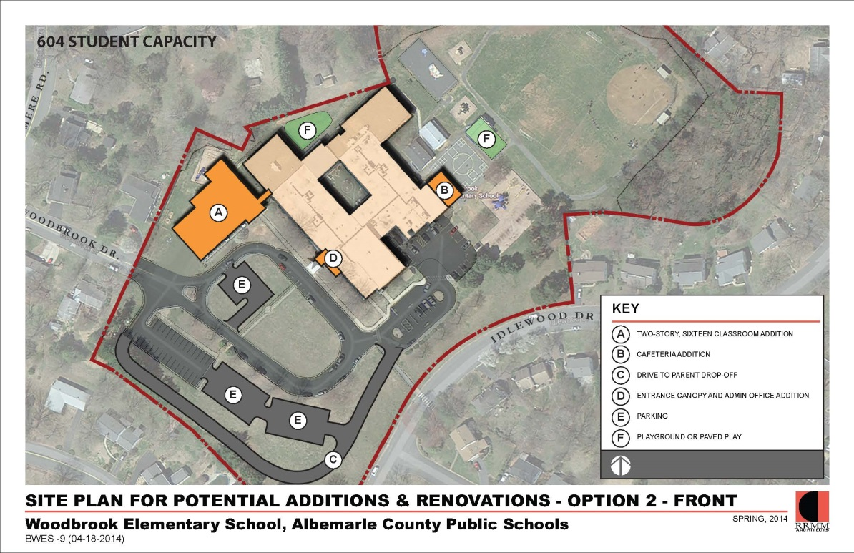
objectives
School Board Approved 4/2/15
#2 Study possible long-term scenarios that would influence the following proposed capital projects:
    Woodbrook Addition
    High School Addition
    (Location TBD)
Notes:
Both of these projects would have a redistricting component to fully utilize the additional capacity.

Slide 10
objectives
Other notes from School Board approved scope:
The following items may be a byproduct of the above mentioned objectives, but will not be the primary focus:
    Potential reductions in numbers of students subject to split feeders
    Creating more balanced demographics between schools

Slide 11
capacity vs. enrollment
*Projections updated based on 9/1/15 enrollment data
High School | Building Capacity | Enrollment (Current +Projections*)
 |  | 9/1/15 | 2016/17 | 2017/18 | 2018/19 | 2019/20 | 2020/21
Albemarle | 1819 | 1941 | 1969 | 2000 | 2009 | 2016 | 2023
Monticello | 1236 | 1144 | 1134 | 1102 | 1083 | 1077 | 1052
Western Albemarle | 1088 | 1071 | 1065 | 1087 | 1092 | 1126 | 1112
High School | Building Capacity | Current & Projected Seat Surplus/Deficiency
 |  | 9/1/15 | 2016/17 | 2017/18 | 2018/19 | 2019/20 | 2020/21
Albemarle | 1819 | -122 | -150 | -181 | -190 | -197 | -204
Monticello | 1236 | +92 | +102 | +134 | +153 | +159 | +184
Western Albemarle | 1088 | +16 | +23 | +1 | -4 | -38 | -24

Slide 12
capacity vs. enrollment
*Projections updated based on 9/1/15 enrollment data
Middle School | Building Capacity | Current & projected Seat Surplus/Deficiency
 |  | 9/1/15 | 2016/17 | 2017/18 | 2018/19 | 2019/20 | 2020/21
Burley | 716 | 166 | 132 | 155 | 120 | 121 | 68
Henley | 949 | 127 | 100 | 109 | 71 | 60 | 5
Jouett | 733 | 136 | 147 | 146 | 139 | 101 | 73
Sutherland | 737 | 135 | 130 | 140 | 149 | 128 | 94
Walton | 534 | 201 | 206 | 183 | 190 | 200 | 200

Slide 13
capacity vs. enrollment
*Projections updated based on 9/1/15 enrollment data
Elementary School | Building Capacity | Enrollment (Current + Projections)
 |  | 9/1/15 | 2016/17 | 2017/18 | 2018/19 | 2019/20 | 2020/21
Greer | 578 | 611 | 647 | 658 | 681 | 671 | 659
Murray | 296 | 253 | 251 | 256 | 255 | 246 | 255
Broadus Wood | 380 | 275 | 258 | 270 | 258 | 261 | 256
Agnor-Hurt | 566 | 538 | 566 | 575 | 579 | 580 | 596
Elementary School | Building Capacity | Current & Projected Seat Surplus/Deficiency
 |  | 9/1/15 | 2016/17 | 2017/18 | 2018/19 | 2019/20 | 2020/21
Greer | 578 | -33 | -69 | -80 | -103 | -93 | -81
Murray | 296 | 43 | 45 | 40 | 41 | 50 | 41
Broadus Wood | 380 | 105 | 122 | 110 | 122 | 119 | 124
Agnor-Hurt | 566 | 28 | 0 | -9 | -13 | -14 | -30

Slide 14
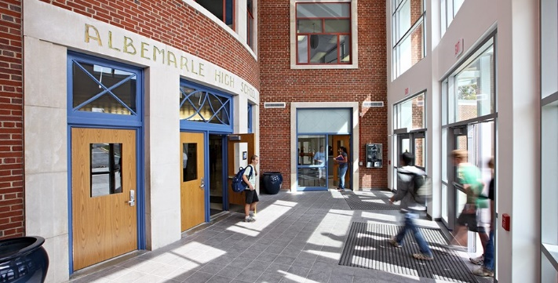
Albemarle High School
Currently 100 students over capacity. Projected to exceed 200 students over capacity in 5 years.
Largest High School in division; Board has instructed to not make bigger
Classroom Utilization
AHS MHS
    8/8 periods 34% 13%
    7/8 periods 36% 6%
    6/8 periods 26% 59%
    >6 /8 periods 4% 22%

Slide 15
Albemarle high School
Point of Comparison |  | Albemarle HS | Monticello HS
Cafeteria* | Size | 6,520 square feet | 5, 593 square feet
 | Capacity | 1,778 students | 1,525 students
 | Ratio | 3.36 | 4.89
Media Center** | Size | 6,093 square feet | 4,677 square feet
 | Capacity | 1,698 students | 1,225 students
 | Ratio | 3.14 | 4.09
Parking | Quantity | 520 Spaces | 554 Spaces
 | Ratio | 0.27 | 0.48
Enrollment |  | 1941 | 1144
Ratio =size(or quantity) / enrollment
*Does not include travel ways; Department of Education Guidelines calculates capacity at 11sf/student with 3 lunch periods.
**Includes main room only; Department of Education Guidelines calculates capacity at 1000 sf +3 sf/student

Slide 16
Albemarle High School
Overcrowding Impact Examples:
Non-optimal classrooms (i.e. no natural light)
Inadequate teacher planning spaces
Overcrowded lunch periods
Insufficient parking
“Room Committee”

Slide 17
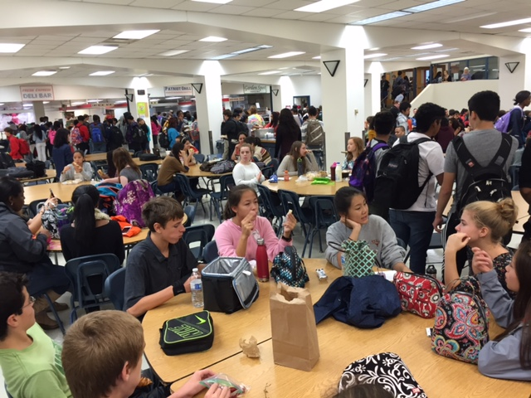
Albemarle High School

Slide 18
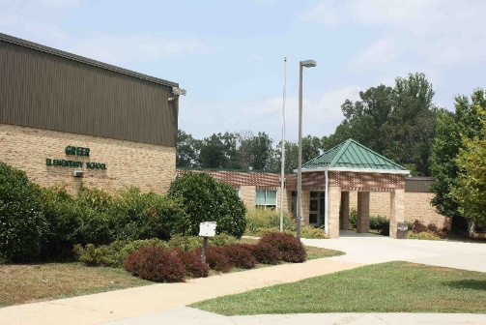
Greer Elementary school
Projected to be almost 100 students over capacity in 3 years.
Currently using non-optimal classrooms for grade-level classrooms (smaller, no natural light)
Currently utilize 2 trailers
Support staff & intervention in the hallway
Pre-K Classes
  Currently serve 53 students in 2 Bright Stars Programs, 1 Headstart Program
  Waitlist
  Graduating a small 5th grade class and welcoming large kindergarten classes

Slide 19
Greer Elementary school
Enrollment by Grade
Year | K | 1st | 2nd | 3rd | 4th | 5th | Total | Diff.
2015/16 | 116 | 115 | 107 | 78 | 82 | 57 | 555 | n/a
2016/17 | 111 | 106 | 112 | 102 | 77 | 83 | 591 | +36
2017/18 | 112 | 101 | 103 | 107 | 101 | 78 | 602 | +11
2018/19 | 119 | 102 | 98 | 98 | 106 | 102 | 625 | +23
2019/20 | 110 | 109 | 99 | 93 | 97 | 107 | 615 | -10
Total: +60

Slide 20
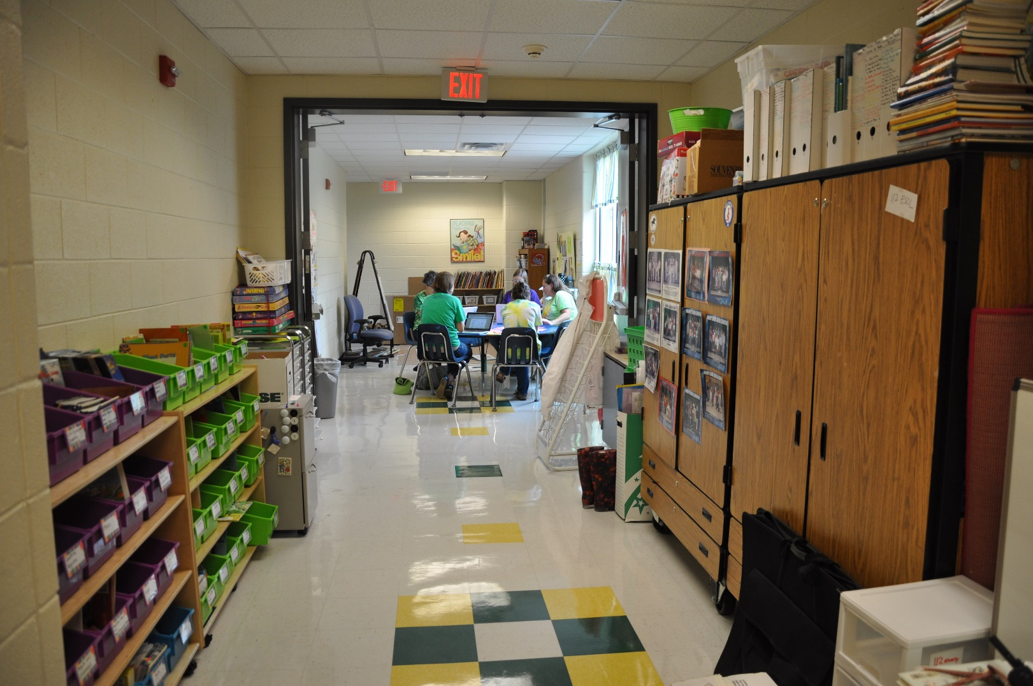
Greer Elementary School

Slide 21
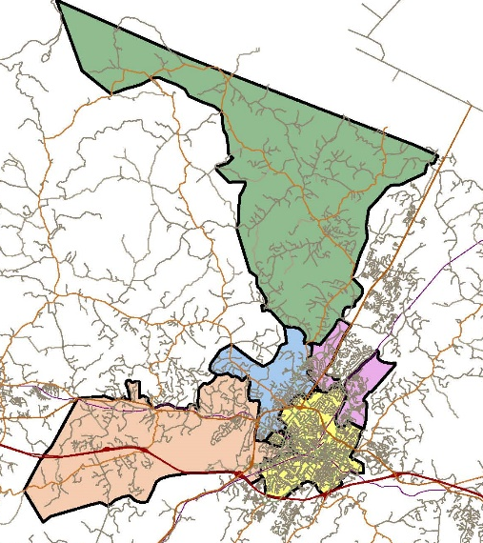
Elementary school boundaries
Broadus Wood Elementary
Agnor-Hurt Elementary
Greer Elementary
V.L. Murray Elementary
City of Charlottesville

Slide 22
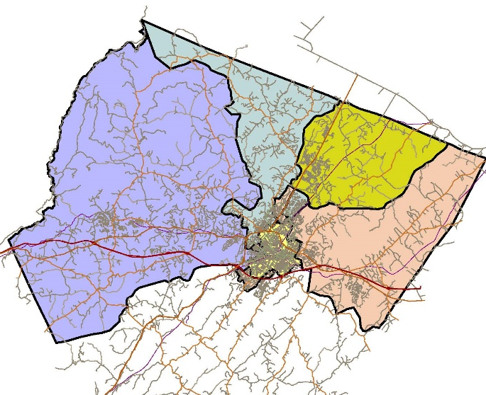
middle school boundaries
Sutherland Middle
Jouett Middle
Henley Middle
City of Charlottesville
Burley Middle
(school located in city)

Slide 23
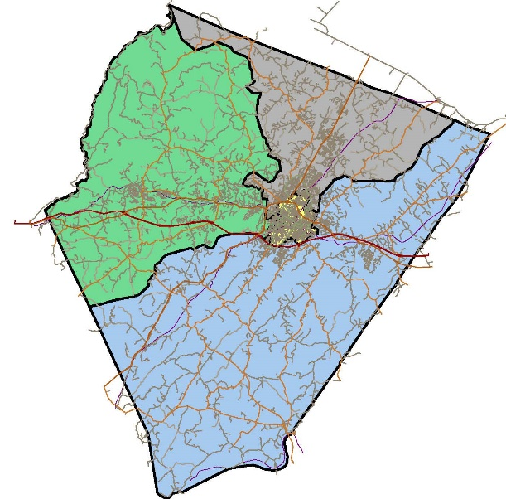
High school boundaries
Albemarle High School
Western Albemarle High School
Monticello High School

Slide 24
Feeder pattern chart
BROWNSVILLE
RED HILL
STONY POINT
66%
CROZET
SCOTTSVILLE
BROADUS WOOD
MERIWETHER LEWIS
CALE
GREER
BAKER BUTLER
63%
MURRAY
YANCEY
STONE ROBINSON
AGNOR-HURT
WOODBROOK
HOLLYMEAD
76%
84%
31%
HENLEY
WALTON
BURLEY
JOUETT
SUTHERLAND
WESTERN ALBEMARLE
MONTICELLO
ALBEMARLE

Slide 25
Committee recommendation
Summary
Notes:
.

Slide 26
Process
  Committee has met 8 times
  Hosted 3 community meetings with public comment
  Utilized a website to grant access to all current information (minutes, presentations, etc.)
  Conducted 3 electronic surveys
    Survey #1: 110 responses
    Survey #2: 83 responses
    Survey #3: 649 responses
  Received correspondence via committee email address
    Email: 53 responses

Slide 27
Criteria considered
Building capacity/projected growth (Appendix B)
Proximity/Travel time (Appendix D)
Feeder patterns (Appendix E)
Contiguous zones
Existing neighborhoods/subdivisions kept together
Minimizing frequency of redistricting
Minimizing numbers of students redistricted
Natural boundaries
Socioeconomic/ethnic/academic diversity (Appendix F)
Opportunity for future expansion

Slide 28
Greer options considered
Option | Relief to Greer | Neighborhoods | Receiving Schools
A | 64 | Colonnades/Old Ivy | Murray ES
B | 51 | Townwood/Squirrel Path | Agnor-Hurt
 |  | University Housing #2 | Murray ES/Burley/Monticello
 |  | Colonnades/Old Ivy | Burley/Monticello
 |  | University Housing #1 | Burley/Monticello
B2 | 62 | Whitewood/Oak Forest | Agnor-Hurt
 |  | University Housing #2 | Murray ES/Burley/Monticello
 |  | Colonnades/Old Ivy | Burley/Monticello
 |  | University Housing #1 | Burley/Monticello
B3 | 45 | Turtle Creek/Commonwealth/Stonefield | Agnor-Hurt
 |  | University Housing #2 | Murray ES/Henley/WAHS
 |  | Old Ivy | Murray ES/Henley/WAHS
C | 86 | Commonwealth S. of Greenbrier-Stonefield | Agnor-Hurt
 |  | Townwood MHP/Triangle/Squirrel Path | Broadus Wood

Slide 29
Greer options considered
Disadvantages of redistricting scenarios:
Inadequate capacity of receiving schools
Inadequate relief to Greer
Changing the school assignment of a neighborhood that was redistricted 3 years ago
One scenario would have moved students out of Agnor-Hurt to make room for Greer students
Significant increases in travel time
Creation of split feeder patterns

Slide 30
Greer elementary
Committee Recommendation:
After exhausting all redistricting options, the committee could not find a viable solution they could recommend to solve the overcrowding at Greer.
Instead, the committee recommends that staff evaluate non-redistricting options that may include housing Greer 5th grade at Jouett Middle School, relocating Greer’s pre-k programs, utilizing mobile classrooms, or other creative solutions that would provide temporary relief until additional seats are built at Woodbrook.
The committee believes there is an immediate need to provide relief to Greer.

Slide 31
Albemarle High school
Committee Recommendation
Transfer of the area of ‘Route 20 north of Proffit Road’ from Sutherland Middle School/Albemarle High School to Burley Middle School/Monticello High School.
Transfer of the area ‘Rio Road East of the railroad tracks and Rio Road East including Abbington and Pine Haven’ from Albemarle High School to Monticello High School.
Allow all current (2015/16 school year) Albemarle & Sutherland students in affected neighborhoods be allowed to finish their years in the school they are currently enrolled.
Allow all siblings of current (2015/16 school year) Albemarle High School & Sutherland students in affected neighborhoods to attend Albemarle High School. This only applies to siblings currently enrolled in ACPS. In all cases, transportation is not provided.

Slide 32
Recommended neighborhoods
Neighborhood | Before | After | Middle | High
Rt. 20 North of Proffit | Stony Point Sutherland Albemarle | Stony Point Burley Monticello | 47 | 70
Rio Road E of R&R Tracks and Rio Road E of Abbington to Pine Haven | Agnor-Hurt Burley Albemarle | Agnor-Hurt Burley Monticello | n/a | 144
A.
B.
Total: 214
*Enrollment is based on 9/7/15 data

Slide 33
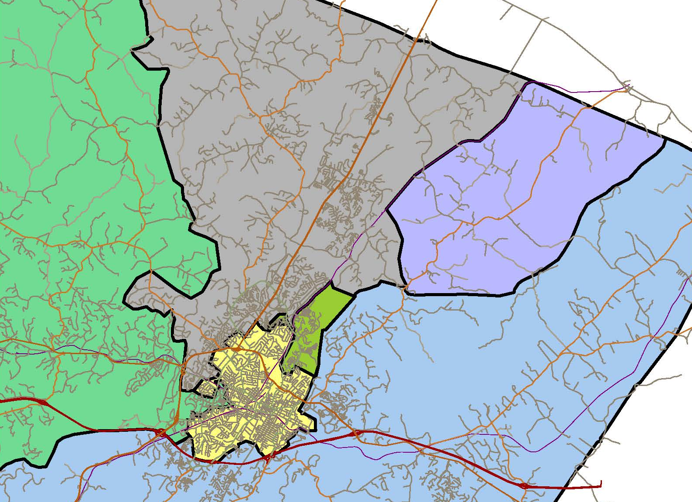
Recommended neighborhoods
ALBEMARLE
Rt 20 North of
Proffit Rd
(47 SUT students
70 AHS students)
MONTICELLO
Rio Road E of R&R Tracks
Rio Road E of Abbington to Pine Haven
(144 AHS students)

Slide 34
Neighborhood enrollment history
Neighborhood | Level | 2010/11 | 2011/12 | 2012/13 | 2013/14 | 2014/15 | 2015/16
Rt 20 North | Elementary | 121 | 99 | 93 | 84 | 76 | 76
 | Middle | 48 | 65 | 54 | 61 | 45 | 47
 | High | 64 | 62 | 67 | 66 | 67 | 70
Rio Road east of R&R incl…. | Elementary | 155 | 187 | 214 | 216 | 224 | 241
 | Middle | 58 | 80 | 89 | 99 | 103 | 102
 | High | 83 | 92 | 114 | 127 | 142 | 144

Slide 35
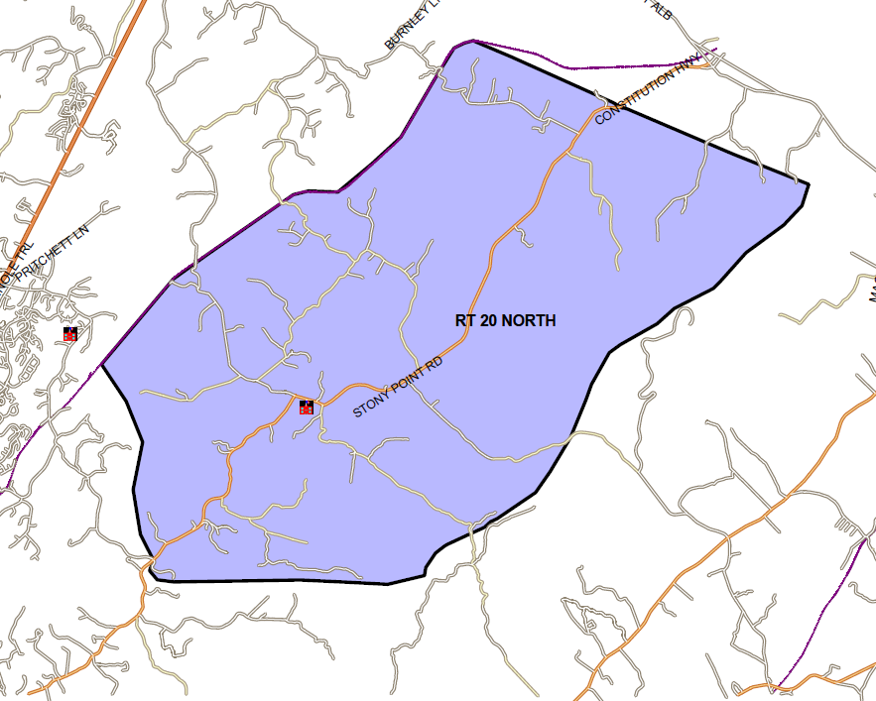
A Rt. 20 North of Proffit Rd.
Current:
Sutherland: 47 students
Albemarle: 70 students
Proposed: Burley/Monticello
Eliminates split feeder pattern at
Stony Point ES:
Currently: 67% Burley
33% Sutherland

Slide 36
A Rt. 20 North of Proffit Rd.
Distance from back of Vineyard Rd to schools (miles)
Before | Sutherland | AHS
 | 17.13 | 20.72
After | Burley | MHS
 | 19.61 | 21.41
Difference | +2.48 | +0.69
Distance from back of Vineyard Rd to schools (minutes)
Before | Sutherland | AHS
 | 43:16 | 43:45
After | Burley | MHS
 | 42:51 | 45:47
Difference | - 0:25 | +2:02

Slide 37
A Rt. 20 North of Proffit Rd.
TRAVEL TIME EXERCISES
20N @ Proffit Intersection
Car#1Route: Proffit Rd to Polo Grounds Rd to Rio Mills Rd. to Seminole Trail to Rio Rd to Hydraulic Rd to Lambs Ln
Car#2 Route: Stony Point Rd to Richmond Rd to I-64W to Monticello Avenue to Scottsville Road to Mill Creek Drive

Slide 38

A Rt. 20 North of Proffit Rd.
TRAVEL TIME EXERCISES
Spring 2015
5/29/15
Fall 2015
9/21/15
20N @ Proffit
Car#1 left @ 8:24 and arrived at AHS @ 8:44
Travel Time: 20 minutes
Car#2 left @ 8:26 and arrived at MHS @ 8:47
Travel Time: 21 minutes
20N @ Proffit
Car#1 left @ 8:24 and arrived at AHS @ 8:43
Travel Time: 19 minutes
Car#2 left @ 8:24 and arrived at MHS @ 8:44
Travel Time: 20 minutes
ALBEMARLE
HIGH SCHOOL
MONTICELLO
HIGH SCHOOL
The purpose of the exercise is to analyze the difference in travel times. Total travel time will be greater the farther a student lives from the intersection, but the increase would be equivalent to either school.

Slide 39
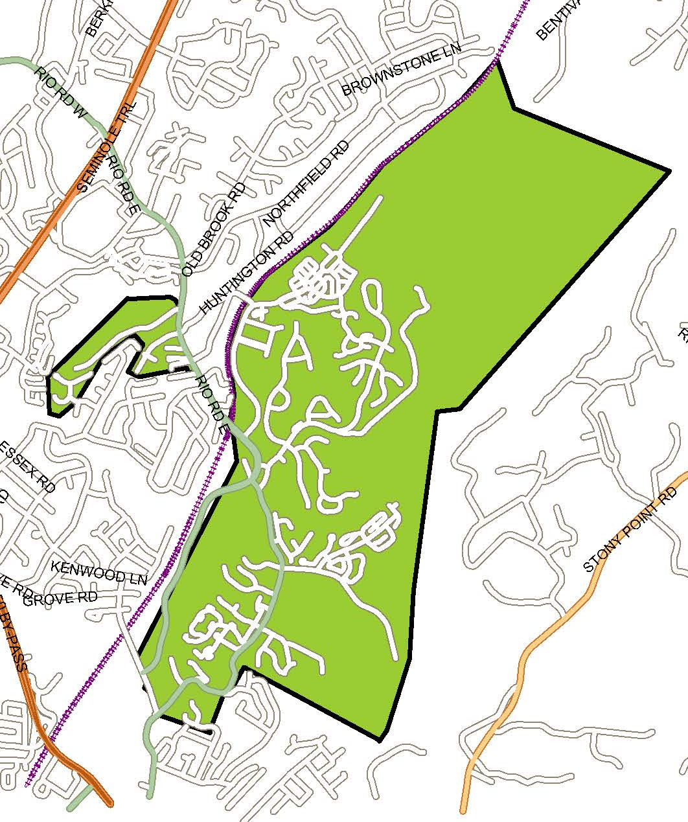
b Rio Rd E. of R&R Tracks and Rio Rd E. of
Abbington to Pine Haven
Current
Albemarle: 144 students
Proposed: Monticello
Remain at Agnor-Hurt, Burley

Slide 40
b Rio Rd E. of R&R Tracks and Rio Rd E. of
Abbington to Pine Haven
Distance from back of Dunlora to schools (miles)
Before | AHS
 | 3.88
After | MHS
 | 6.77
Difference | +2.89
Distance from back of Dunlora to schools (minutes)
Before | AHS
 | 12:12
After | MHS
 | 16:27
Difference | +4:15

Slide 41
b Rio Rd E. of R&R Tracks and Rio Rd E. of
Abbington to Pine Haven
TRAVEL TIME EXERCISES
Rio Road East @ Chapel Hill Road
Car #1 Route: Rio Rd E to Park St to High St to 9th St NE to Avon St to Mill Creek Drive
Cottonwood Drive @ Wildwood Ct
Car #2 Route: Cottonwood Dr to North Ave to Park St to Rio Rd to Hydraulic to Lambs Ln

Slide 42
b Rio Rd E. of R&R Tracks and Rio Rd E. of
Abbington to Pine Haven
Spring 2015
5/29/15
Fall 2015
9/21/15
MONTICELLO
HIGH SCHOOL
Rio Road East @ Chapel Hill Road
Car#1 left @ 8:24 and arrived at MHS @ 8:42
Travel Time: 18 minutes
Rio Road East @ Chapel Hill Road
Car#1 left @ 8:30 and arrived at MHS @ 8:51
Travel Time: 21 minutes
ALBEMARLE
HIGH SCHOOL
Cottonwood Drive @ Wildwood Ct
Car#2 left @ 8:30 and arrived at AHS @ 8:49
Travel Time: 19 minutes
Cottonwood Drive @ Wildwood Ct
Car#2 left @ 8:25 and arrived at AHS @ 8:44
Travel Time: 19 minutes

Slide 43
Demographic comparisons

Slide 44
Demographic comparisons

Slide 45
Capacity utilization
Redistricting Impact with No Grandfather Clause
1 year:
2016/17
5 year*:
2020/21
*Based on 5 year projections of school enrollment +/- the affected neighborhood’s current high school enrollment. It does not reflect any growth in the neighborhood enrollment as that information is not available.

Slide 46
Capacity utilization
Redistricting Impact with Recommended Grandfather Clause**
**For this exercise, it is assumed that 100% of students and sibling elect to remain at Albemarle who have the option. Each incoming class is the average grade level of the current high school enrollment in the affected neighborhoods (214/4) minus the number of siblings that could elect to attend at Albemarle.

Slide 47
Feeder pattern changes
After Recommendation
BROWNSVILLE
RED HILL
STONY POINT
CROZET
SCOTTSVILLE
BROADUS WOOD
MERIWETHER LEWIS
CALE
GREER
BAKER BUTLER
63%
MURRAY
YANCEY
STONE ROBINSON
AGNOR-HURT
WOODBROOK
HOLLYMEAD
76%
84%
14%*
HENLEY
WALTON
BURLEY
JOUETT
SUTHERLAND
WESTERN ALBEMARLE
MONTICELLO
ALBEMARLE
* 74 middle students living in Minor Ridge/Four Seasons/ Commonwealth/Dominion Dr

Slide 48
Other options considered
Neighborhood | Current Boundary
Minor Ridge/Four Seasons/ Commonwealth/Dominion Dr | Agnor-Hurt, Burley, Albemarle
Abbington Crossing/ Raintree/Northfields/Huntington | Woodbrook, Jouett, Albemarle
Colonnades/Old Ivy | Greer, Jouett, Albemarle
University Housing #2: Farrish, Seymour, Copley, etc. | Greer, Jouett, Albemarle
University Housing #1: Mimosa, Summit, Stadium, Buckingham Circle, etc. | Murray, Henley Western Albemarle
(Please reference written report for full details on why options were not recommended)

Slide 49
Other options considered
Transfers to Western Albemarle High School
Allow voluntary transfers
Build a New Northern High School
Build an addition onto Albemarle High School
Utilize Mobile Classrooms/Trailers
Relocate the Math, Engineering & Science Academy (MESA)
(Please reference written report for full details on why options were not recommended)

Slide 50
Objective #2
Woodbrook Addition
The committee would like to stress the importance and urgency of the Woodbrook Addition as a means to solve the overcrowding at Greer and the projected overcrowding in other urban ring schools. The committee endorses the School Board’s CIP request in regards to the size and schedule of this project.
Monticello High School Addition
The committee recommends monitoring the need for this addition. It may be needed to accommodate current and recommended neighborhoods; however, it may be a challenge to find additional neighborhoods to move into Monticello’s boundary to occupy the additional seats.

Slide 51
Superintendent Recommendation

Slide 52
recommendation
Dr. Pam Moran endorses the committee’s recommendation with one alternative for consideration regarding the grandfather clause.
Alternative:
“All current Albemarle High and Sutherland Middle students be permitted to finish their years in the schools in which they are enrolled. Siblings of current Albemarle High students who are currently at Sutherland and Burley Middle Schools would be grandfathered for attendance at Albemarle High. Transportation will not be provided by the school division to families who choose to grandfather. The choice to grandfather for the 2016/17 school year will need to be made no later than January 29th, 2016.”

Slide 53
Grandfather clause
Clause as recommended by
committee would apply to:
Current Students: 162
Siblings: 87
Total: 249
Rt 20 Proffit Rd North
Current AHS Students |  | Siblings of Current AHS Students
Grade |  | 8th | 7th | 6th | 5th | 4th | 3rd | 2nd | 1st | K
11th | 16 | 1 | 1 |  | 2 |  | 1
10th | 20 | 4 | 2 | 1
9th | 15 |  | 2 | 4 | 1 | 4 |  | 2 |  | 1
Total | 51 | 5 | 5 | 5 | 3 | 4 | 1 | 2 | 0 | 1
Sibling Total: 26
Rio E of R&R Tracks
Current AHS Students |  | Siblings of Current AHS Students
Grade |  | 8th | 7th | 6th | 5th | 4th | 3rd | 2nd | 1st | K
11th | 32 | 3 | 3 | 5 |  | 1 |  | 1 |  | 1
10th | 49 | 6 | 4 | 6 | 1 | 2 | 5 |  |  | 1
9th | 30 | 2 | 5 | 8 | 1 |  | 2 | 2 | 2
Total | 111 | 11 | 12 | 19 | 2 | 3 | 7 | 3 | 2 | 2
Sibling Total: 61

Slide 54
precedents
Hollymead, 2012
“Extend a ‘grandfather privilege’ for families of rising 5th graders and their siblings that are currently enrolled at Hollymead Elementary to stay at Hollymead through 5th grade.”
Agnor-Hurt, 2014
“All rising fifth graders and their siblings are permitted to remain at Agnor-Hurt for one more year.”
County-wide study, 2006 (last time high school students were redistricted)
“All students be allowed to finish their years in the school in which they are enrolled when the redistricting plan is implemented. A few caveats follow:
  Transportation would not be provided
  Younger siblings not currently in the school would not be grandfathered with older siblings
  The school would work with each affected family to make a decision within a defined timeline.”

Slide 55
Next steps
Answer questions this evening
School Board Public Hearing: November 5th
School Board Vote: November 12th

